Slide 1
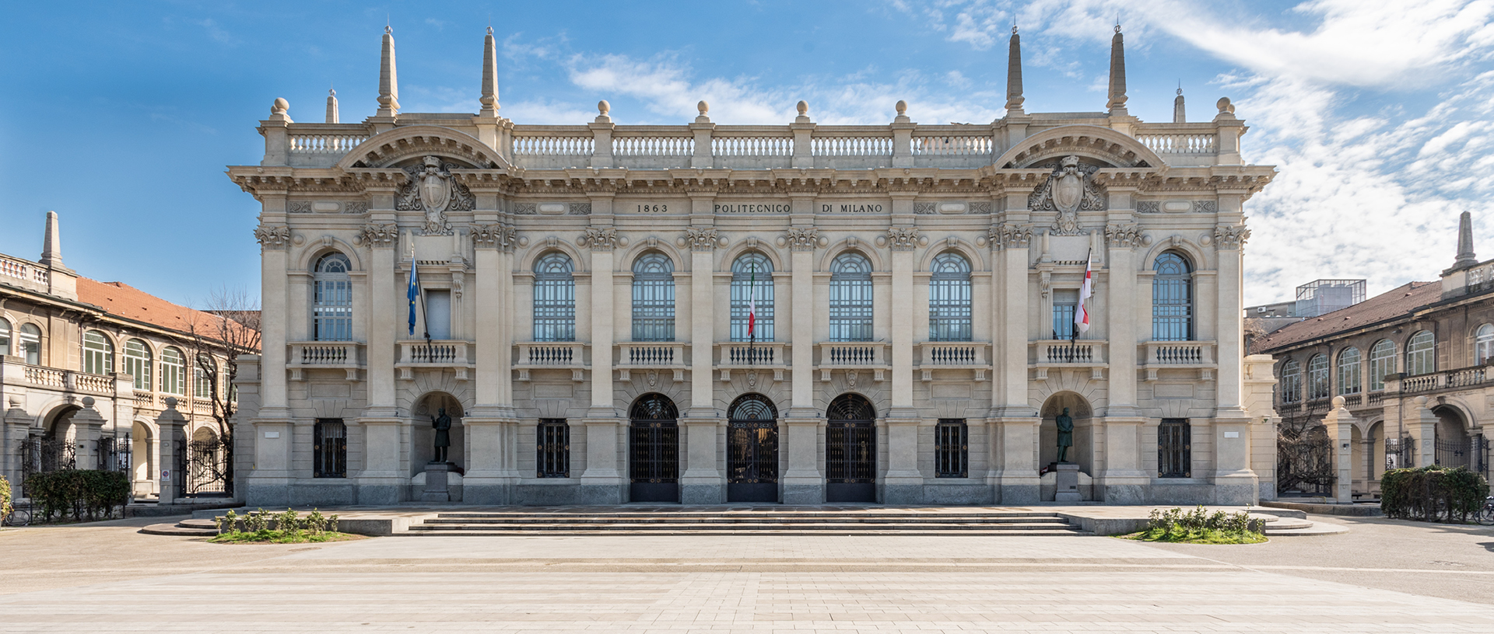

Titolo presentazione sottotitolo
COMPUTER MUSIC-LANGUAGES & SYSTEMS
FABFOUR | HOMEWORK #2 | Analysis of Existing JUCE plugin
Milano, XX mese 20XX
Presented by:
Amico Stefano Antonio(10937333)
Anand Abhijeet(10859656)
Pletti Manfredi(10493741)
Portentoso Alice(10664207)
Presented to:
Prof. Fabio Antonacci
Prof. Marco Olivieri

Slide 2
ABOUT OBERHEIM OB-X
1979: Introduced as Oberheim OB-X synthesizer designed by Tom Oberheim
First synthesizer to feature polyphonic capabilities based on single printed circuit board “voice card”.
It held 32 user-programmable pre-sets built in Z-80 microprocessors which also automated the tuning process.
Songs featuring OB-X: https://www.wikiwand.com/en/Oberheim_OB-X#Albums_and_songs_featuring_OB-X
2016: Release of Oberheim OB-Xd plug-in developed by George Reales
Github link: https://github.com/reales/OB-Xd
Commercial software site: https://www.discodsp.com/obxd/
Features modern components/package while still retaining the classic analog sound of the original which provides a vintage appeal.
Two oscillators per voice, a 24dB/octave low-pass filter, two ADSR envelopes, and a single LFO.
Songs featuring OB-Xd: "Blinding Lights" by The Weeknd , "Lose Control" by Meduza, Becky Hill, and Goodboys.
Plug-in Analysis Repo: https://github.com/polimi-cmls-23/group6-hw-JUCE-Fab_Four

Slide 3
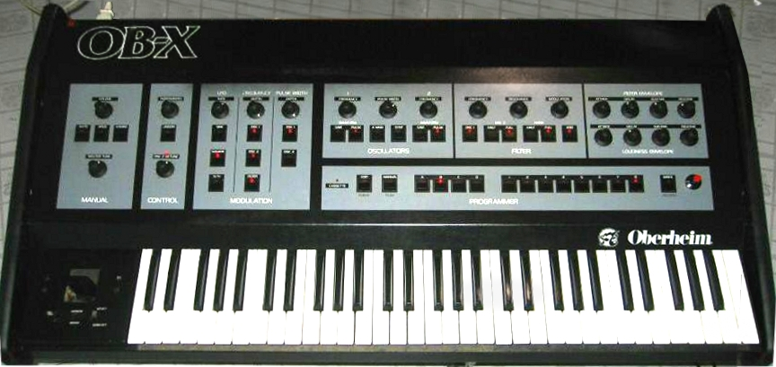
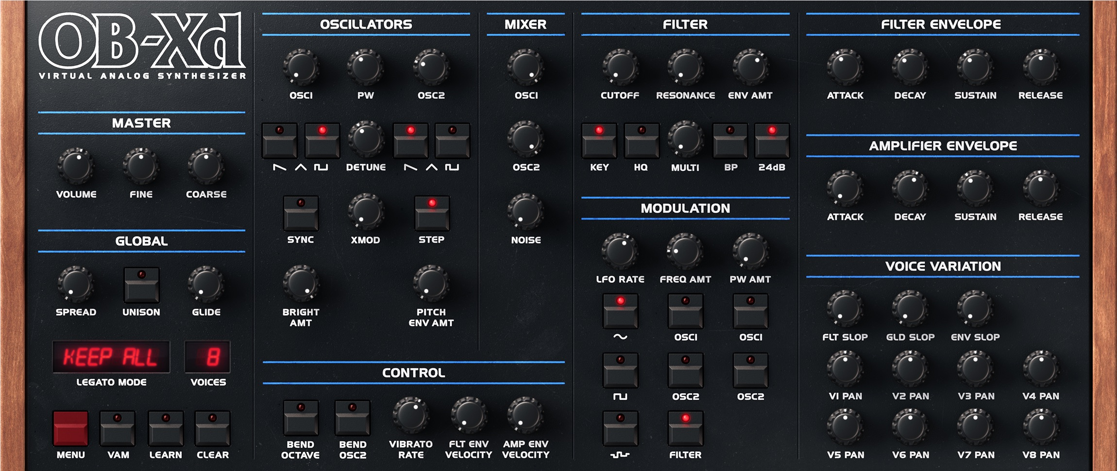
PHYSICAL SYNTH vs PLUG-IN
PHYSICAL SYNTH
PLUG-IN
Includes many different header files in the GUI like FLEXBOX and GRID.
Includes various components like multi-touch support and accessibility features depending on the platform (iOS, Android, Windows etc.)

Slide 4
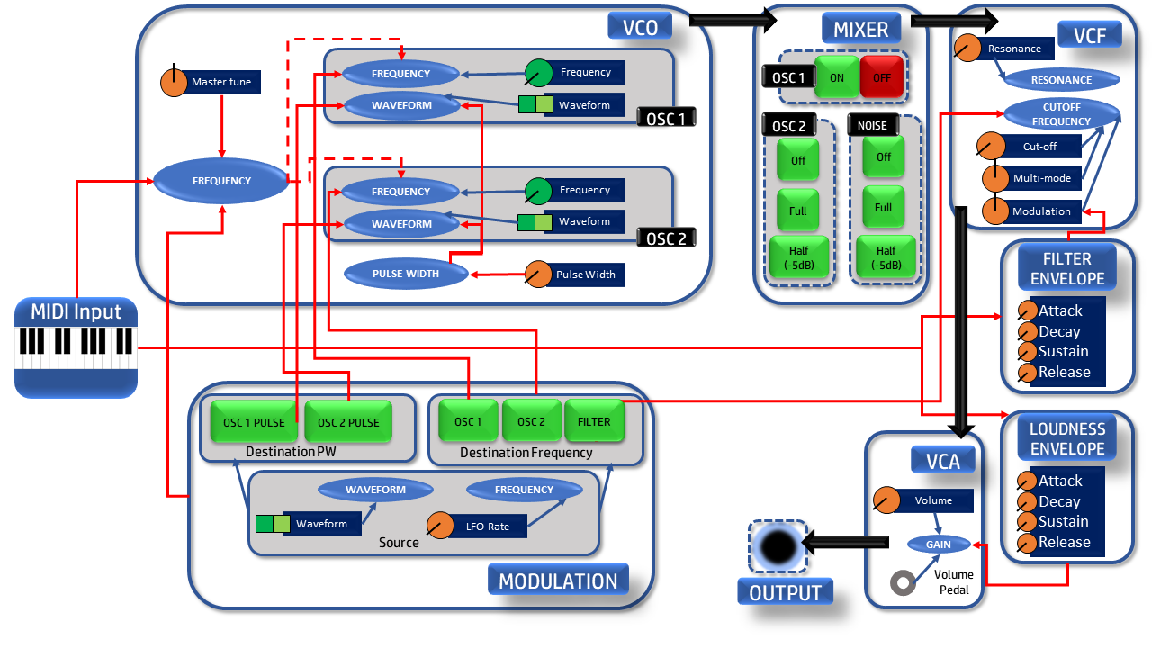
PLUG-IN BLOCK DIAGRAM

Slide 5
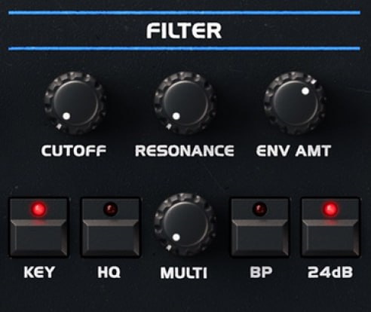
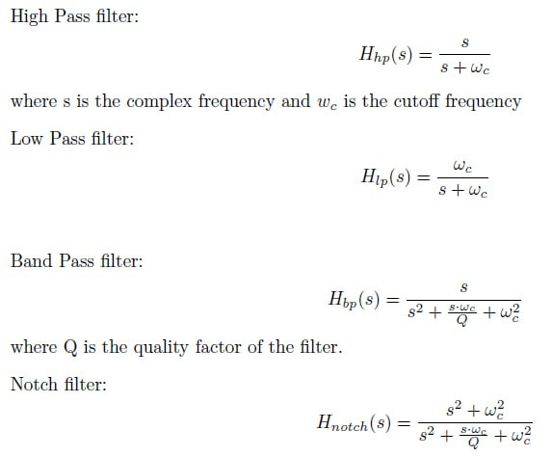
CONTINUOUS BLENDABLE MULTIMODE FILTER

Slide 6
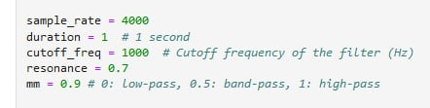
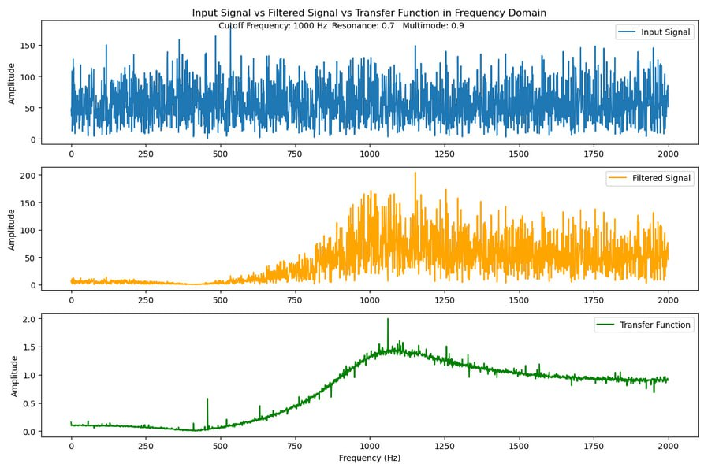
BLENDABLE FILTER PYTHON IMPLEMENTATION
Link to the code: https://github.com/polimi-cmls-23/group6-hw-JUCE-Fab_Four/blob/main/MM-FabFour.ipynb

Slide 7
THANKS
FOR YOUR KIND ATTENTION !

